Slide 1
Reducing
Staff Attrition
By Neel, Sudin, Punit, and Harrison

Slide 2

What is Staff Attrition?

Slide 3
Staff Attrition: The loss of employees in a company due to various possible reasons that are natural or voluntary i.e. resignation, pregnancy, retirement
Staff attrition comes at a huge cost for employers.
Money is lost, work is lost, and time is lost.
How can we determine and alleviate the most significant predictors of job attrition in order to retain our employees?
Notes:
Staff attrition comes at a huge cost for employers.
Definition: the loss of employees in a company through various possible reasons that are natural or voluntary i.e. resignation, pregnancy, retirement
Money is lost, work is lost, and time is lost. Hence, it would be worthwhile to come up with measures that will help retain a company’s employees
Our Goal: to use machine learning and classification to predict potential employee loss in order to prevent it
Classification will be based off variables /features that may influence the outcome of whether employee chooses to leave a company
We will quantify our variables and feed them into our model for prediction

Slide 4
Our Goal
Use machine learning and classification trees to predict potential employee loss to prevent it
Classification will be based off attributes from the EmployeeAttrition dataset that may influence an employee’s attrition
We will quantify our variables and feed them into our model for prediction
Notes:
Our Goal: to use machine learning and classification to predict potential employee loss in order to prevent it
Classification will be based off variables /features that may influence the outcome of whether employee chooses to leave a company
We will quantify our variables and feed them into our model for prediction

Slide 5

Data Exploration

Slide 6
The EmployeeAttrition dataset contains the following data on each employee:
Statistical Data: Age, Hourly Rate, Total Working Years, etc.
Descriptive Data: Education, Environmental Satisfaction, Job Involvement, Job Satisfaction, Performance Rating, Relationship Satisfaction, Work Life Balance, Marital Status
Notes:
Using a combination of the statistical and descriptive data, we should be able to conduct some analysis to find any relationships to predict which individuals are likely to leave in the coming years of employment.
A quick look at the data to see if there are any clear abnormalities and trend that are visible right off the bat

Slide 7

Methodology

Slide 8
Use Logistic Regression Modeling to determine which features are positive, statistically significant predictors (<0.05) of employee attrition
Develop & Compare data-driven decision-making solutions by analyzing the dataset using:
Logistic Regression Modeling
Decision Trees
Graph/Plot Results
Notes:
Using a combination of the statistical and descriptive data, we should be able to conduct some analysis to find any relationships to predict which individuals are likely to leave in the coming years of employment.
A quick look at the data to see if there are any clear abnormalities and trend that are visible right off the bat

Slide 9

Results

Slide 10
Statistically Significant Predictors of Staff Attrition:
Age
Business Travel Frequency
Distance From Home
Environment Satisfaction
Job Involvement
Job Level (4)
Job Satisfaction
Years With Manager
Marital Status (Single)
Number of Companies Previously Worked At
Over Time
Relationship Satisfaction
Work-Life Balance
Years In Current Role
Years Since Last Promotion
Notes:
Using a combination of the statistical and descriptive data, we should be able to conduct some analysis to find any relationships to predict which individuals are likely to leave in the coming years of employment.
A quick look at the data to see if there are any clear abnormalities and trend that are visible right off the bat

Slide 11
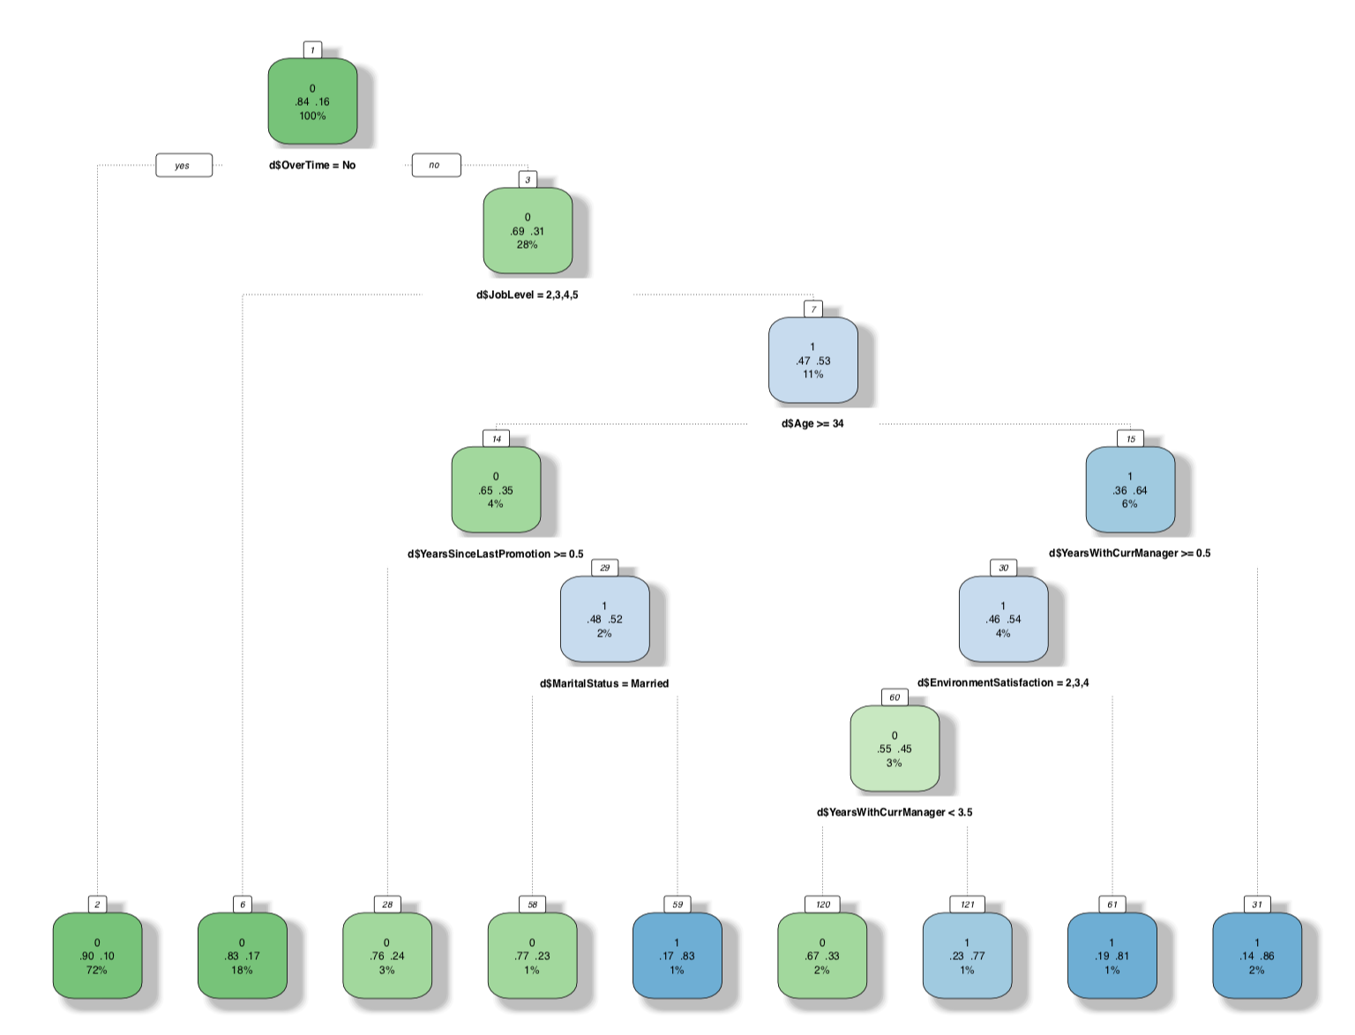
Notes:
Using a combination of the statistical and descriptive data, we should be able to conduct some analysis to find any relationships to predict which individuals are likely to leave in the coming years of employment.
A quick look at the data to see if there are any clear abnormalities and trend that are visible right off the bat

Slide 12
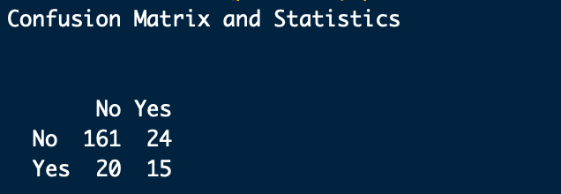
Precision = 0.4285714
Recall = 0.3846154
Accuracy : 0.8
Notes:
Using a combination of the statistical and descriptive data, we should be able to conduct some analysis to find any relationships to predict which individuals are likely to leave in the coming years of employment.
A quick look at the data to see if there are any clear abnormalities and trend that are visible right off the bat

Slide 13

Conclusion

Slide 14
Strategies to Reduce Staff Attrition Rates
Companies can reduce:
Business travel frequency: By having more online meetings
Distance from home: By hiring employees living closer to the company/offices
Marital Status (Single): Hiring employees with families
Number of companies previously worked at: Hiring new employees and transitioning interns to full-time employees
Overtime: Distributing work more evenly among employees to ensure fewer overtime instances
Years since last promotion: Promote some employees more frequently
Notes:
Using a combination of the statistical and descriptive data, we should be able to conduct some analysis to find any relationships to predict which individuals are likely to leave in the coming years of employment.
A quick look at the data to see if there are any clear abnormalities and trend that are visible right off the bat

Slide 15
Areas for Improvement
Large Variance in Statistical Significance of Predictors - Lower alpha to 0.01 to allow the model to better fit the data
The Logistic Regression Model did not predict the data with high accuracy since the differences between the results was statistically significant.
Confusion Matrix presented a low accuracy rate
Notes:
Using a combination of the statistical and descriptive data, we should be able to conduct some analysis to find any relationships to predict which individuals are likely to leave in the coming years of employment.
A quick look at the data to see if there are any clear abnormalities and trend that are visible right off the bat
Hosmer and Lemeshow Goodness of Fit test

